Slide 1
SANTHOSH S BATCH: DMT6 TOPIC: Crafting Compelling Web Presences

Slide 2
Apple Product
MAC,
IPAD
IPHONE
WATCH
ENTERTAINMENT
SERVICES
.
Mac Book Pro, Mac Mini, Mac Studio
Mini, Apple Pencil, Keyboards
Iphone 15 Pro, 14, SE
Watch Apple Series 9, Ultra 2, Nike
Apple Tv, Music, Book

Slide 3
DESCRIPTIONS
MacBook Pro now supports hardware-accelerated ray tracing. It's a significant leap in MacBook Pro's graphics capabilities.
USB-C to Apple Pencil Adapter is required to work with iPad (10th generation). Intuitive interaction via responsive touchscreen.
MagSafe and AirTags enhance Apple product user experience with innovative charging and tracking solution HDR Display: Enhanced contrast/color, True Tone: Adaptive color temp, Wide Color (P3): Vibrant hue, Haptic Touch: Tactile feedback etc
Apple Pay. Customization. Digital keys. Family Setup. Fitness tracker. Health monitoring. Maps. Notifications and messaging.
Music, movies, TV shows, stickers, books, and app purchases (from the iTunes Store, App Store, and Book Store). These are billed at the time of purchase

Slide 4
2. What is a platform of website developed tools ?
HTML
JAVA SCRIPT
CSS
Word Wrap

Slide 5
3.Responsive design and mobile optimization
REPORTS
Home pages responsive design
explain Shoping link is a Colbert sentence.
Iphone menu home online shop sentence can’t full explain
Apple product details responsive design
Airpods poster half letters abd half page showing

Slide 6
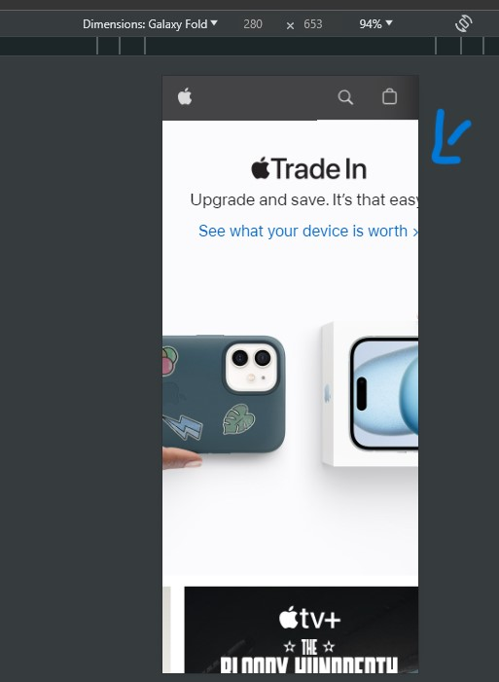
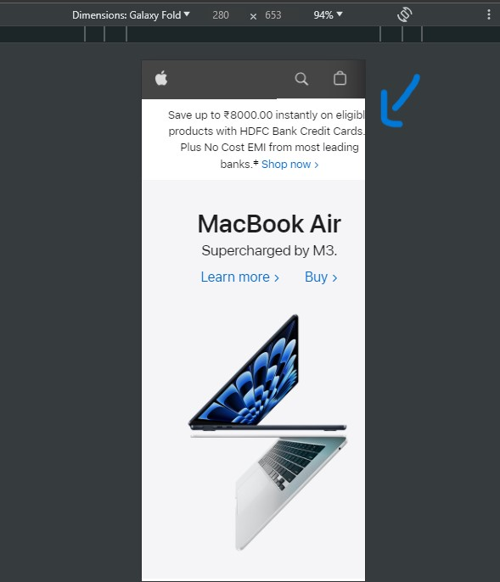
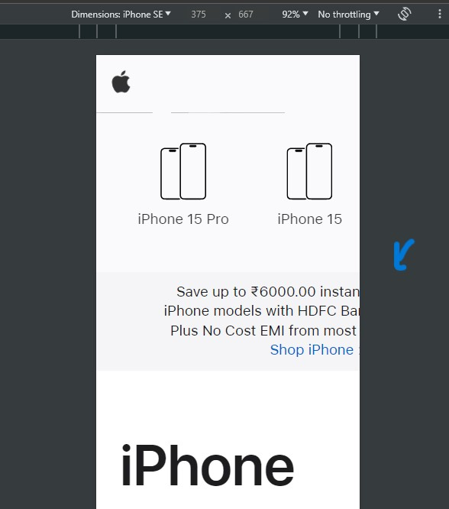
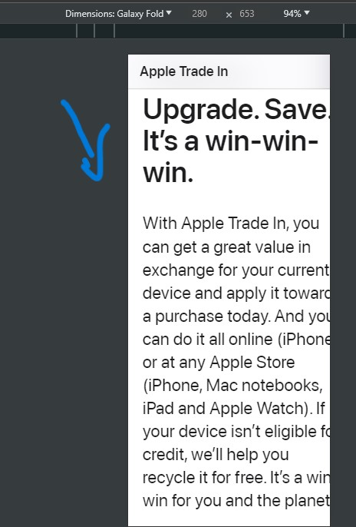

Slide 7
4.website design mistakes and Resolve
The mobile responsive apple website and apply product ads sometime slowing work.
smart watch layout design haven’t full design cover
HomePod mini audio layout design half design cover not full screen showing.
Airpods layout design not full screen
Mobile details photos and word half design cover

Slide 8
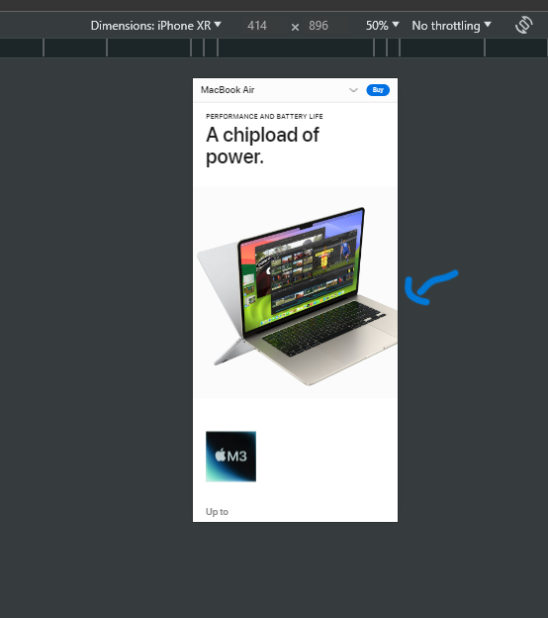
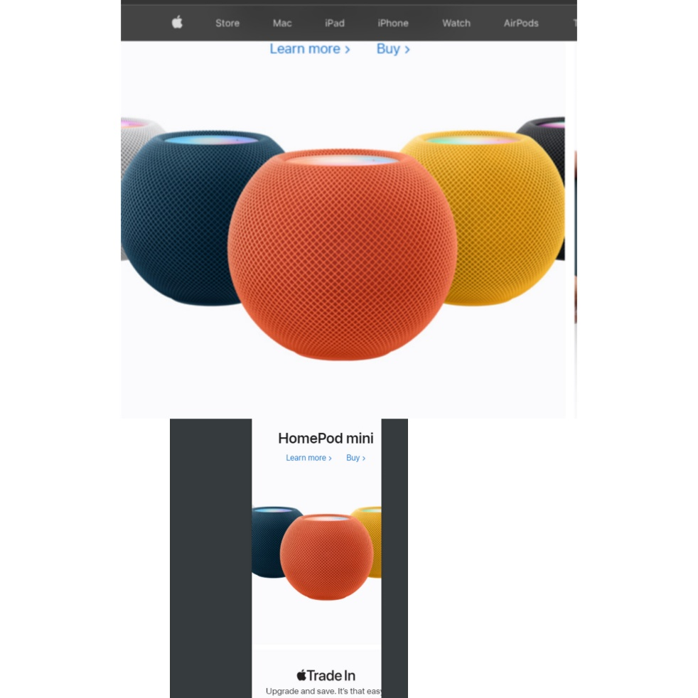
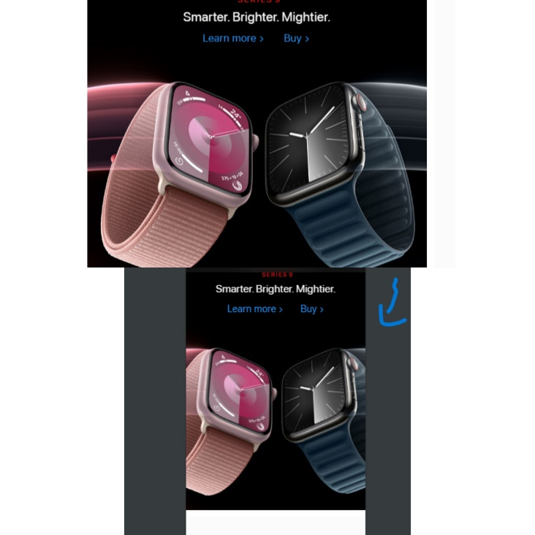
Website design and layout mistake

Slide 9
5.creating visually appealing and user-friendly website designs.
Simplicity: Keep it clean and focused.
High-Quality Imagery: Use sharp visuals effectively.
Clear Navigation: Make it easy to find what users need.
Consistent Branding: Ensure uniformity for brand recognition.
Responsive Design: Optimize for all devices.
Fast Loading Times: Speed matters for user satisfaction.
Whitespace: Use it to enhance readability.
Engaging Visuals: Capture attention with dynamic elements.
Accessibility: Ensure everyone can use the site.
User-Centric Design: Prioritize user needs and preferences.

Slide 10
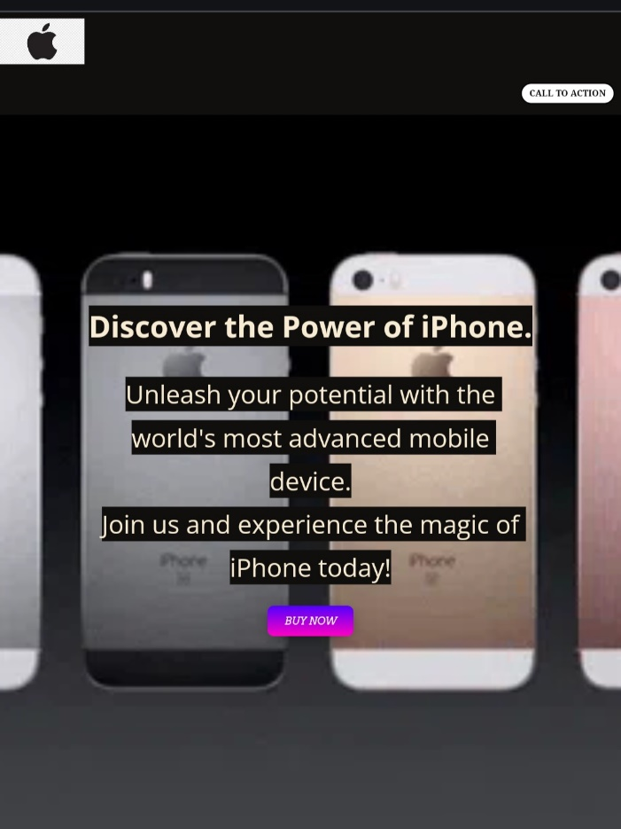
Iphone Landing Page (link: https://ai-campaign-lps-4879.gr-site.com/ )

